Slide 1

Digital Marketplace for Open-Source Software
Empowering Developers, Supporting Open Source Presented by: Tobi Adeoye | Group 3

Slide 2
Project Overview
Overview of Our Design
A secure, user-friendly e-commerce platform for buying, selling, and donating open-source software.
Tailored for developers, businesses, and open-source enthusiasts.
Accessible via desktop with a responsive interface.

Slide 3

Core Features
Core Features
What the Platform Offers
Product Catalog: Rich listings with images and descriptions.
User Management: Profile control, and order history.
Shopping Cart & Checkout: Real-time pricing, multiple payment options, secure checkout.
Security First: Multi-factor authentication, encrypted transactions, data privacy, firewall.

Slide 4
The Problem We Address
Not Just Another GitHub!
At first glance, you might think this is like GitHub — but it’s not.
While GitHub is a fantastic platform for version control and collaboration, it doesn't support monetization. Developers who pour hours into creating powerful open-source tools often walk away with no financial return.
The Gaps We’re Filling:
No built-in way to sell, license, or offer premium support for open-source projects on GitHub.
Developers are left to figure out donations, sponsorships, or external shops, which fragment their efforts.
Businesses searching for open-source solutions often need custom features and reliable support — things they’re willing to pay for, but can't easily get through traditional platforms.
Our platform addresses all of this — by turning open-source into a marketplace, not just a repository.

Slide 5
Our Solution
How Our Platform Helps
Creates a revenue stream for developers.
Offers a trusted marketplace for businesses to find reliable OSS.
Promotes sustainability and innovation in the open-source community.
Very user friendly

Slide 6
Project Structure Design
System Architecture Overview
Our platform is built using a modular three-tier architecture:
1. Client Side (Frontend)
Built for the web using responsive design.
Interfaces with users for browsing products, managing profiles, and making purchases.
Technologies: Built using WordPress frameworks.
2. Server Side (Backend)
Handles business logic, authentication, and secure data operations.
Processes user requests and communicates with databases and payment services.
Technologies: Hostinger hosting.
3. Databases (DBs)
Relational DB (e.g., PostgreSQL): Stores user data, orders, product listings.
NoSQL DB : Caches sessions, supports real-time features, handles reviews.
Follows encryption and backup best practices for security and reliability.

Slide 7
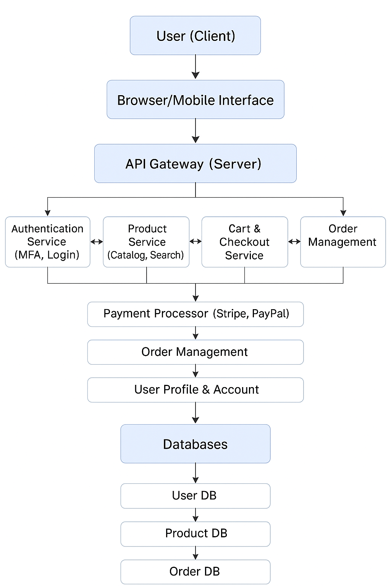
Data Flow Diagram
Notes:
User (Client)
The customer using a browser or mobile app to interact with your e-commerce platform.
🌐 Browser/Mobile Interface
The frontend the user sees — it could be a website or a mobile app UI.
🖥️ API Gateway (Server)
Acts as a single entry point for the frontend to talk to the backend services.
It routes requests to the appropriate services (e.g., login, product listing, checkout).
🧩 Backend Microservices
Authentication Service (MFA, Login)
Handles user login, registration, and multi-factor authentication (MFA).
Product Service (Catalog, Search)
Manages product listings and search functionality.
Cart & Checkout Service
Handles adding items to the cart, managing the cart, and processing checkouts.
Order Management
Manages order creation, tracking, and history.
💳 Payment Processor (Stripe, PayPal)
External services used to handle payment processing securely.
📦 Order Management (Again)
Receives confirmation from the payment processor and updates the order status.
👤 User Profile & Account
Stores user-specific information such as addresses, order history, and preferences.
🗃️ Databases
Core data storage split by functionality:
User DB: Stores user information and credentials.
Product DB: Stores product details, inventory, etc.
Order DB: Stores order history, payment status, shipping info.
This structure is modular, scalable, and secure, making it ideal for modern e-commerce platforms. Want help designing or implementing a specific part of this architecture?

Slide 8
Security Used
Wapiti: A web vulnerability scanner that checks your site for security issues like XSS or SQL injection.
WPScan: A WordPress security scanner that finds known vulnerabilities in themes, plugins, and core files.
Wordfence firewall: A WordPress security plugin with a firewall and malware scanner to protect your site.
miniOrange 2-factor: A plugin that adds two-factor authentication (2FA) for logging into WordPress.
Google Authenticator: An app that generates time-based codes for two-factor authentication.
Google reCAPTCHA verification: Protects your site from spam and bots using image or checkbox challenges.
SSL: Encrypts data sent between the user’s browser and your site (uses HTTPS).
Secure payment gateways: Trusted systems (like Stripe or PayPal) that handle online payments securely.

Slide 9
Results and Analysis
Security Assessment Results
We conducted a thorough vulnerability assessment to ensure the safety and reliability of our platform.
Tools Used:
Wapiti: Used for general vulnerability scanning (e.g., SQL Injection, Cross-Site Scripting).
WPScan: Specifically used to assess vulnerabilities in WordPress plugins, themes, and configurations.
Wordfence firewall: It is used to stops known malicious IPs and bots before they reach your site. Also, it prevents brute-force login attempts, XML-RPC attacks, and credential stuffing.

Slide 10
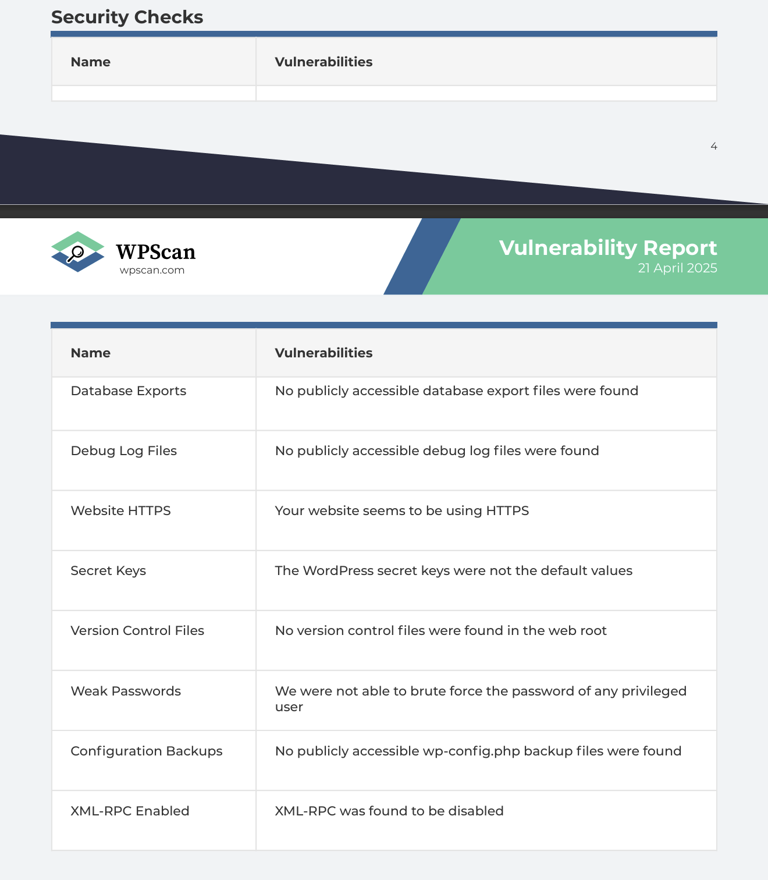
WPScan Findings
WordPress Vulnerability Assessment Report (April 21, 2025)
All scanned plugins were found to be secure.
No known vulnerabilities in major plugins like Elementor, WooCommerce, Jetpack, and Give.
No publicly accessible sensitive files (e.g., wp-config.php, debug logs, or database exports).
Weak passwords were not detected during brute-force testing.
Site uses HTTPS with secure secret keys and disabled XML-RPC.
Conclusion: The WordPress instance is currently well-hardened with no critical vulnerabilities detected in scanned components.

Slide 11
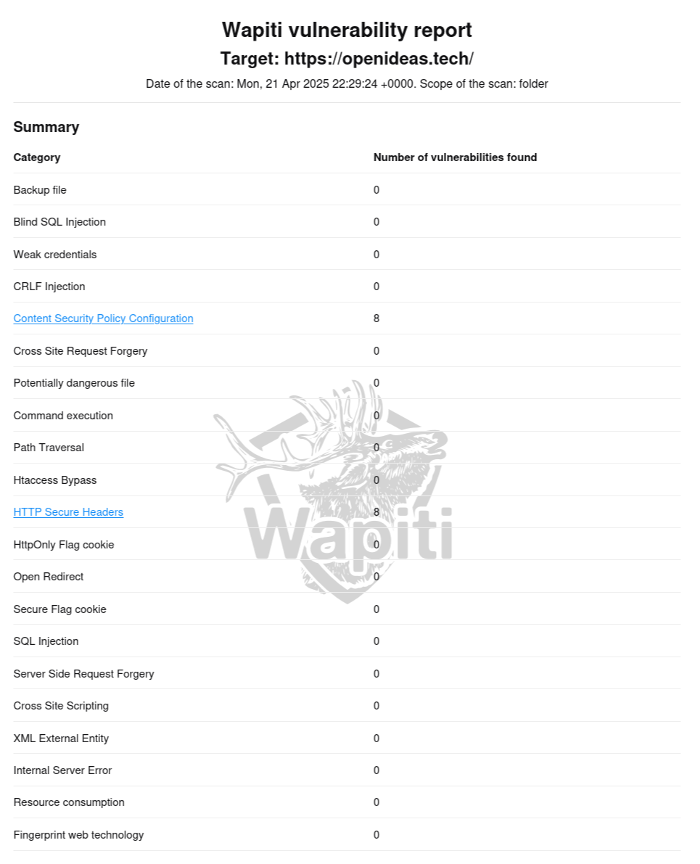
Wapiti Findings
Target: https://openideas.tech Scan Date: April 21, 2025
No critical vulnerabilities found.
Common attack vectors such as SQL Injection, XSS, CSRF, and command injection were not present.
Minor Issues Detected:
Missing Content Security Policy (CSP) attributes: default-src, script-src, object-src, base-uri.
Missing HTTP security headers: X-Frame-Options, X-XSS-Protection, X-Content-Type-Options, Strict-Transport-Security.
Solution: Configure security headers and CSP in server settings to prevent content injection and improve browser-side protection.
Notes:
CSP is used to prevent Cross-Site Scripting (XSS) and data injection attacks. Missing these attributes can allow attackers to inject malicious scripts.
Missing HTTP Security Headers
These headers harden the security of web applications at the HTTP level
Why This Matters
If you're running a public-facing site or web app and these headers are missing:
Your site becomes a bigger target for attacks.
Users can be exposed to malicious scripts or hijacked sessions.
It might fail security audits or vulnerability scans (like from tools such as OWASP ZAP, Burp Suite, etc.).

Slide 12
Summary of Activities
What We Did
Designed a digital marketplace architecture with a strong focus on user experience and modular backend services.
Prioritized Security by integrating multi-factor authentication using miniOrange2-factor, secure payment gateways, data encryption, and Wordfence firewall .
Assessed Security Posture using Wapiti and WPScan:
Wapiti identified minor security header misconfigurations.
WPScan found no critical plugin or theme vulnerabilities.
Analyzed Results and proposed next steps to harden the system before full deployment.

Slide 13
Key Takeaways/Final Thought
What We Learned
Monetizing open-source software is possible with the right infrastructure — it just needs the right platform.
Security isn't a one-time task — it's an ongoing process that must evolve with the application.
Automated tools like Wapiti and WPScan are critical for early vulnerability detection.
Transparency and developer empowerment can coexist with strong, enterprise-grade protections.
Open-source doesn't mean unsupported — and innovation doesn't have to be unpaid. Our platform is designed to bridge that gap and power a more sustainable, secure open-source future.

